Slide 1

Theory of narrow-band mode-locking
厦门大学：罗塞雨
导师：蔡志平教授

Slide 2
Abstract
It should be emphasized that the mode locking of lasers can be thought as two types of balance: The balance between pulse broadening and pulse shortening; the balance between the phase shift by GVD and one by nonlinearity (self-phase modulation).
If the former balance is not obtained, the mode locking pulses will not occur; if only the former balance is obtained, the mode-locking pulses can occur but will be unstable; if both balances are obtained, the stable mode locking pulse will occur.

Slide 3
Abstract
Basically, Stark effect makes multiple longitudinal modes oscillating simultaneously become possible.
What’s more， gain-line splitting (Stark splitting) induced by an intra-cavity laser field can form a dip or dips in gain-line shape, with which a balance between pulse broadening and pulse shortening can be achieved. That is to say, the first balance is obtained and the gain medium with such a gain-line shape can produce short pulses. [1986, J. J. Sanchez-Mondragon]
Since the Stark splitting is symmetric, there is no additional group-velocity dispersion (GVD). The SML pulses without dispersion compensation will occur in those lasers whose gain media have a dip in the gain-line shape, if the nonlinearity and GVD of the host materials can be neglected.
[1986, J. J. Sanchez-Mondragon]. “Pulse compression caused by a spectral hole in an inhomogeneously broadened line of an amplifier”, Centro de Investigaciones en Optica, A. C., Apdo. Postal 948, Leon, Gto. 37000, Mexico

Slide 4
Abstract
Narrow gain width makes mode-locking easier (so it can start mode-locking by itself): stronger intra-cavity laser field owing to larger gain can generate frequency shift of the Stark splitting, which is beneficial to mode-locking.
Since the gain width is small, the allowed oscillation frequencies are limited, which means less longitudinal laser modes would anticipate in mode-locking, leading to a possibly less stable mode-locking state with a larger pulse width in the time domain compared with that of large gain width laser gain material.

Slide 5
Abstract
By increasing the laser cavity length, thus reducing the fundamental frequency of the cavity, more stable mode-locking lasers could be attained with shorter pulse width in the time domain.
The above statement is true on condition that the pulses would be sustained in the extended long laser cavity. Fortunately, that is true for our Pr:YLF solid-state laser. The extended laser cavity is in the air, there should be no phase shift by GVD or by nonlinearity (self-phase modulation).

Slide 6
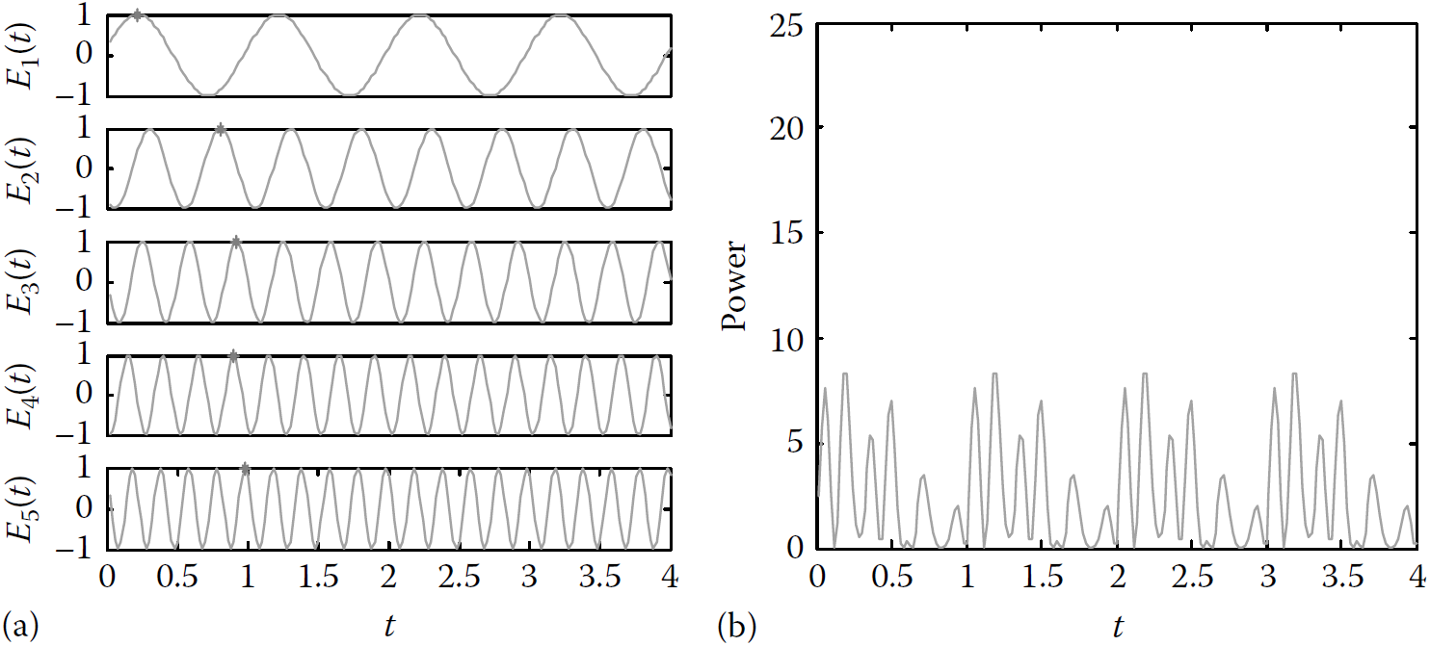
1. Mode-Locking Theory
a laser can oscillate at a number of resonant frequencies whose spacing is equal to the fundamental frequency ω_{R} of the cavity:
The output electric field of the generated lightwave in the temporal domain is the summation of all the oscillating modes given as

Slide 7
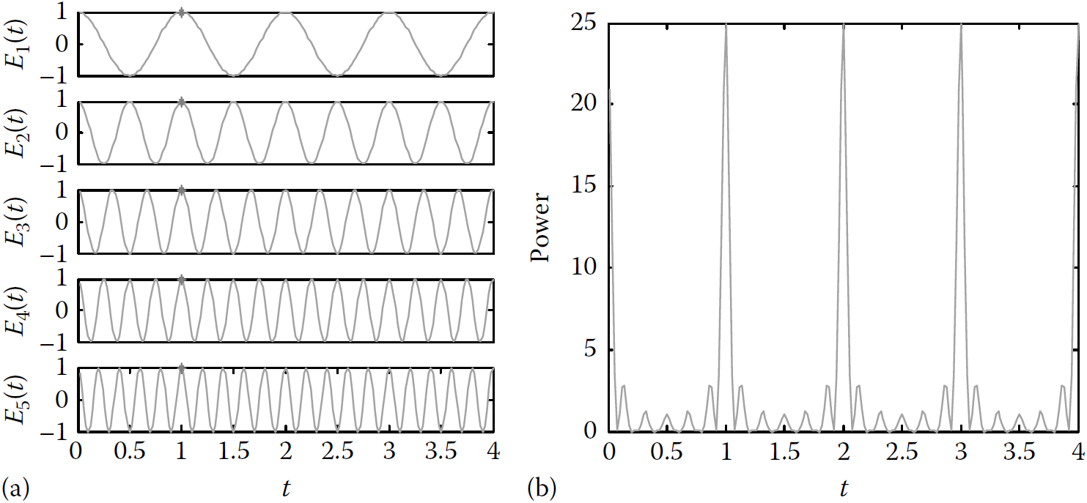
when the modes are forced to lock together, that means all the N modes are either in phase or different in a multiple number of 2π, E_{n}
and Φn will be constants. The simplest case is when E_{n} = 1, and Φ_{n} = 0
which is an oscillation at frequency ω₀ modulated with the sinc envelope function. The average power is thus given by

Slide 8
The periodic train of pulses that have the following properties
the pulse period is T = 2π/ω_{R};
the peak power is N times the average power;
the peak field amplitude is N times the amplitude of a single mode;
the pulse width, defined as the time from the peak to the first zero, is τ =T/N, which shortens as N increases.

Slide 9
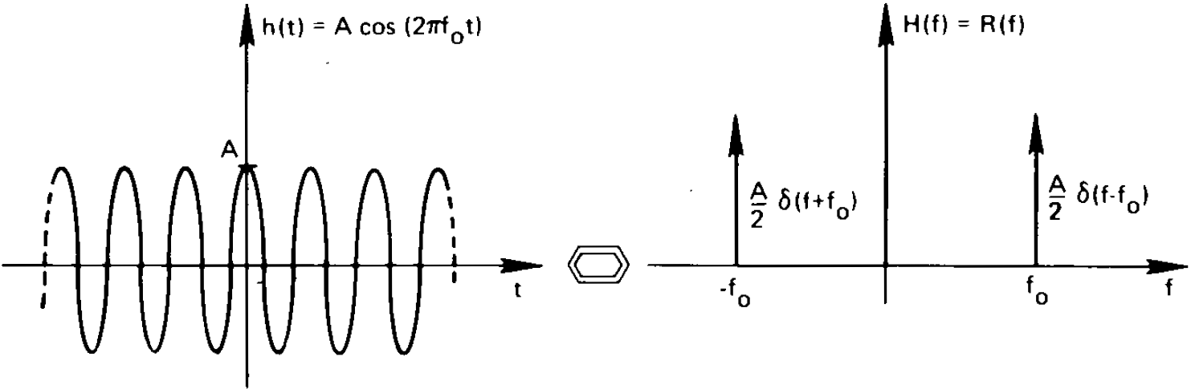
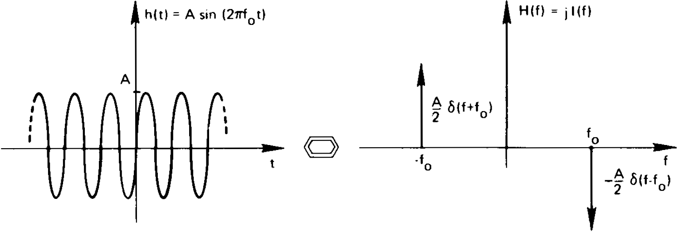
Appendix: Fourier Transform
Note that the Fourier transform is imaginary

Slide 10
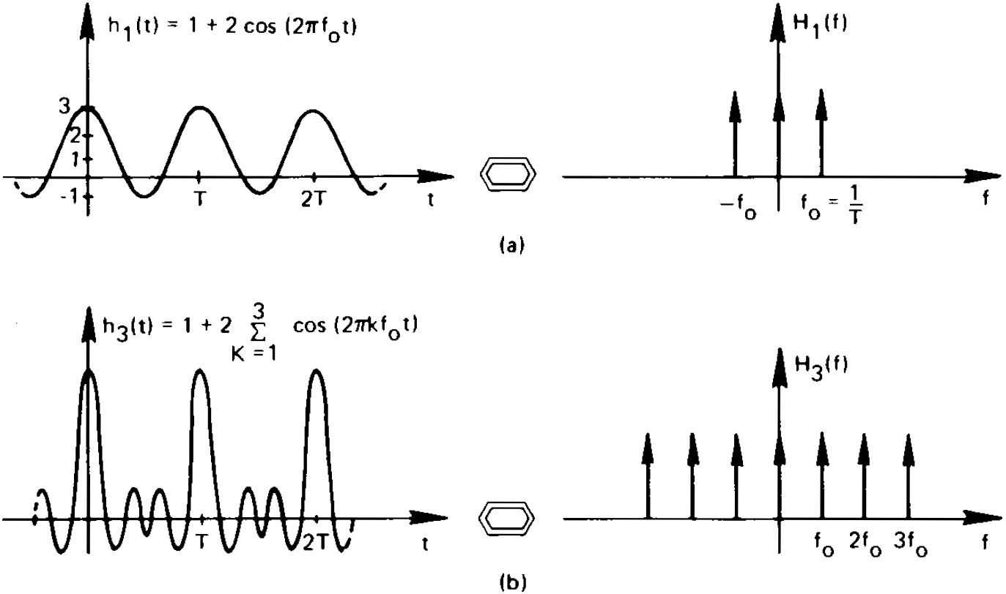
Graphical development of the Fourier transform of a sequence of equal distant impulse function

Slide 11
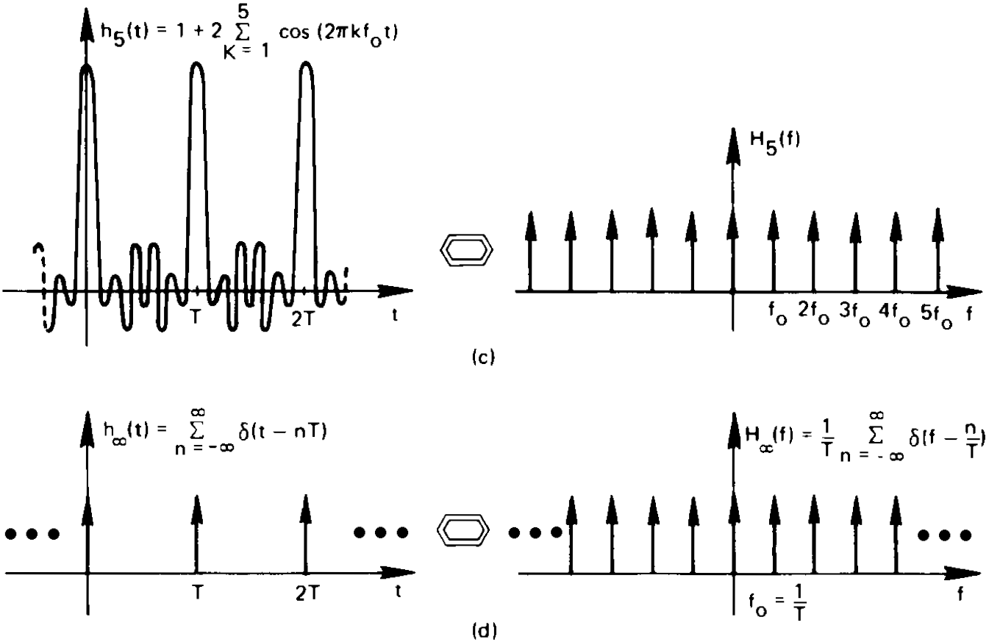

Slide 12
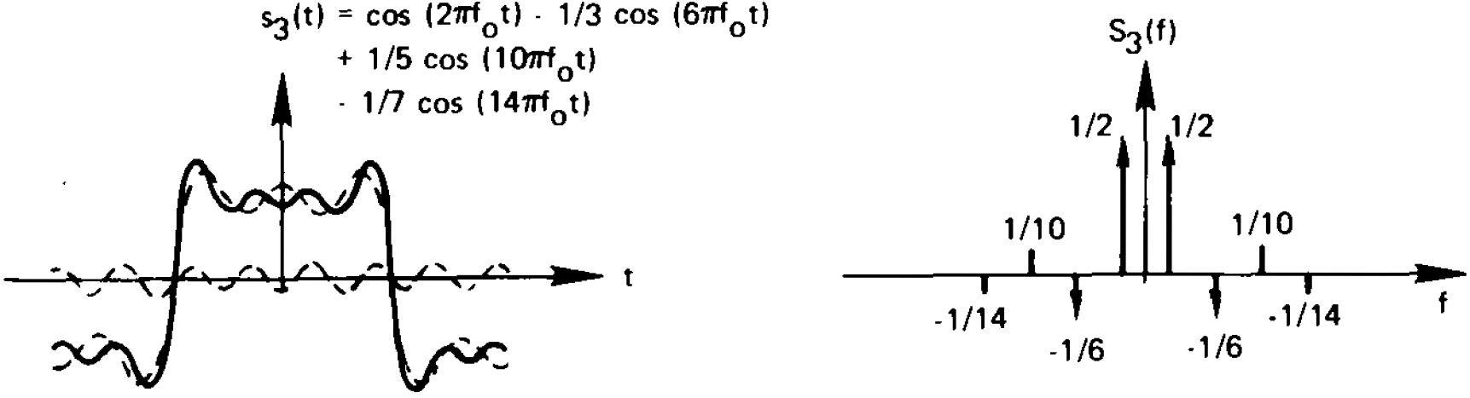
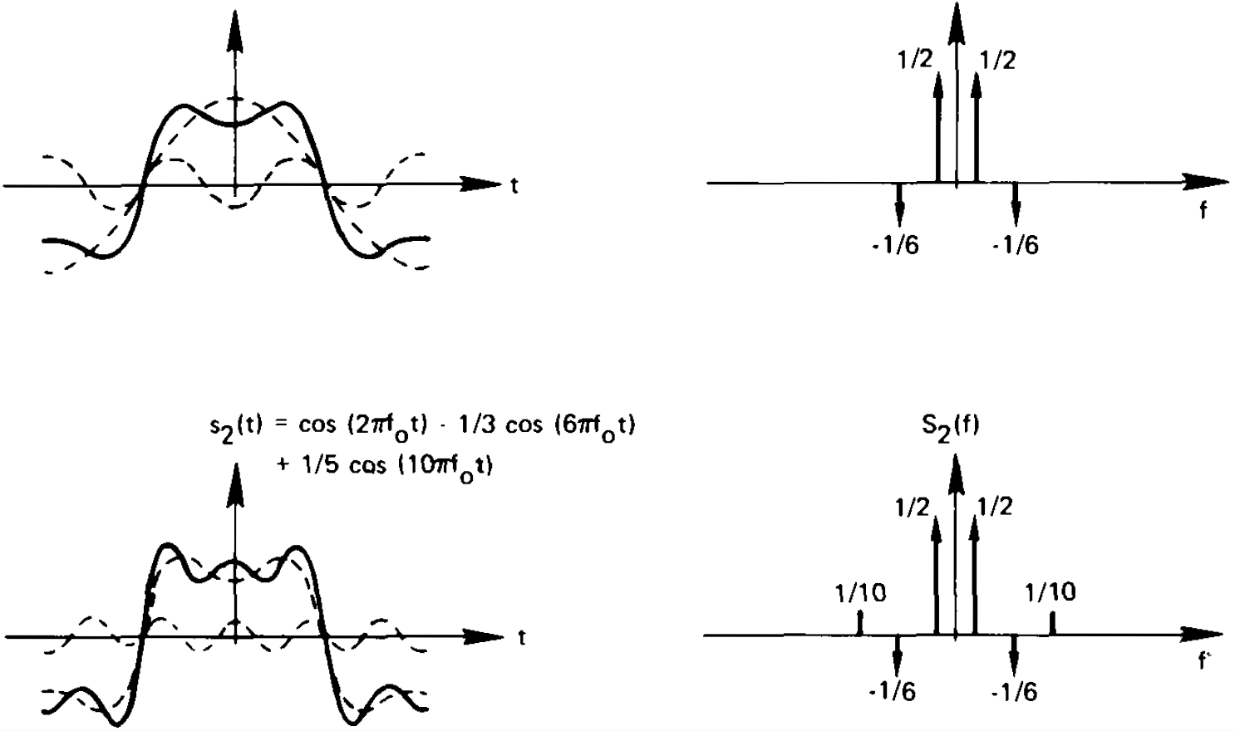
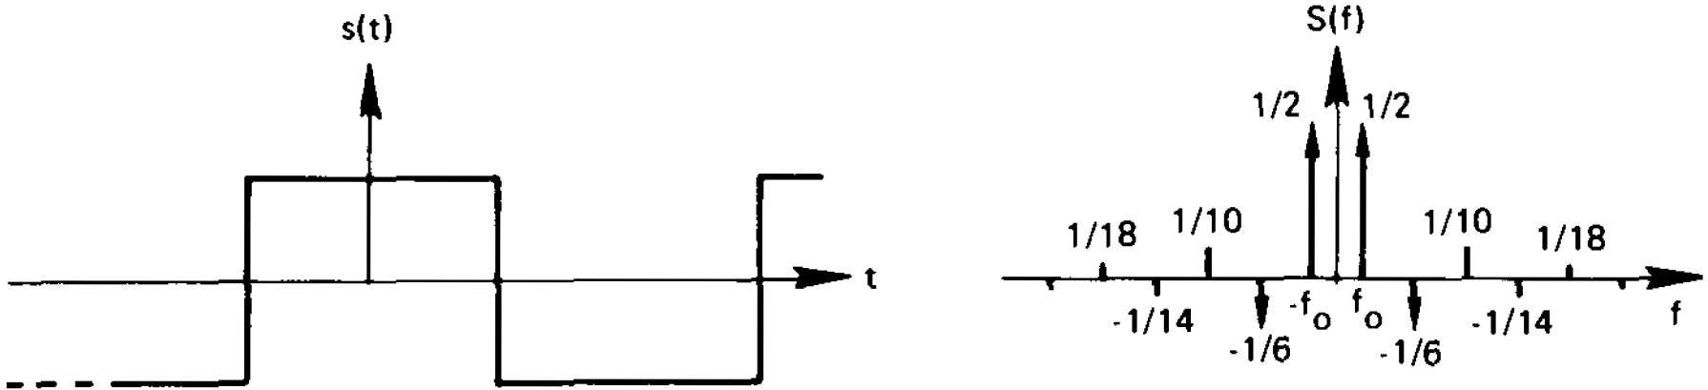
Fourier transform of a square wave function (Fourier series)

Slide 13
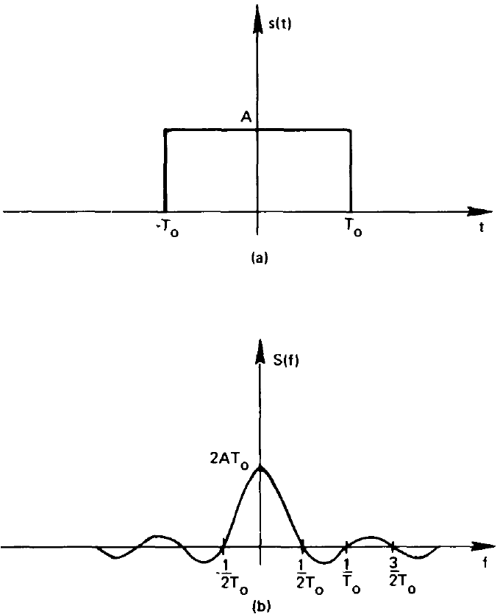
Fourier transform of a pulse waveform

Slide 14
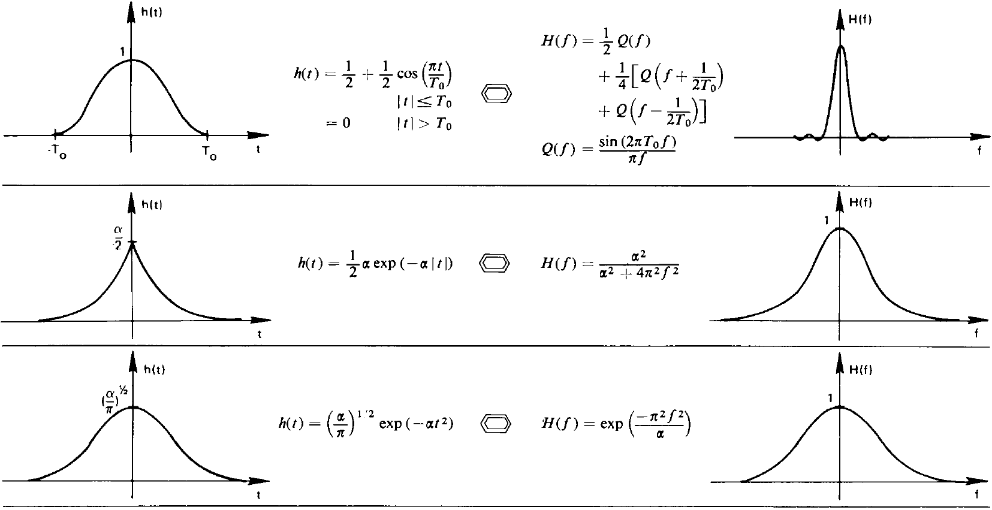
Lorentzian line shape
Gaussian line shape

Slide 15
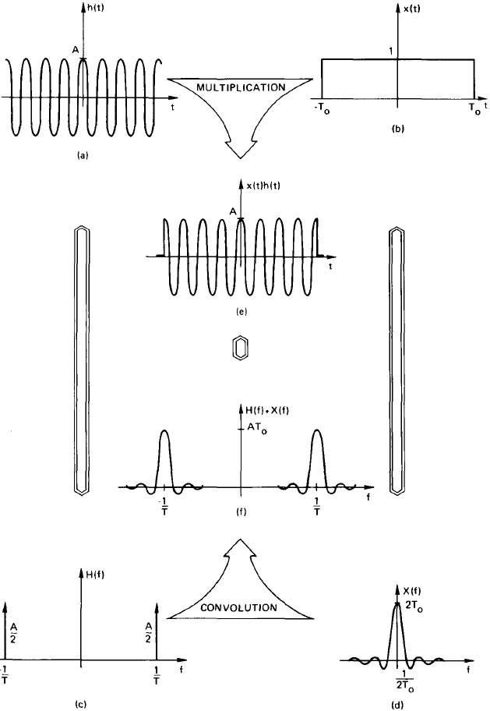
Frequency Convolution Theorem

Slide 16
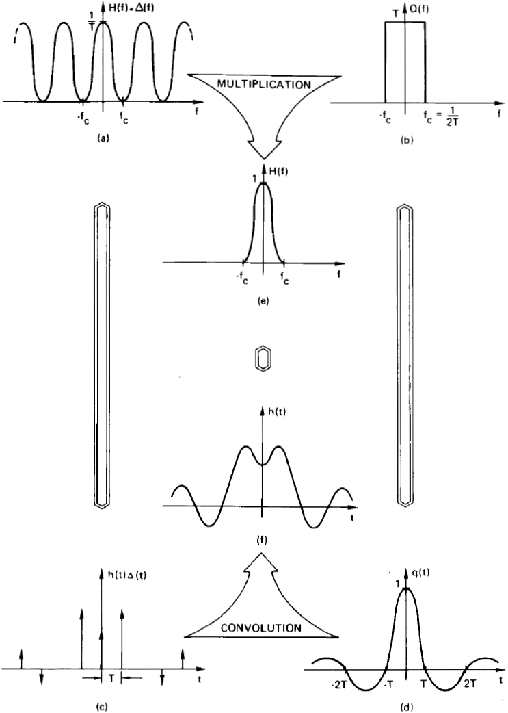
Graphical derivation of the sampling theorem

Slide 17
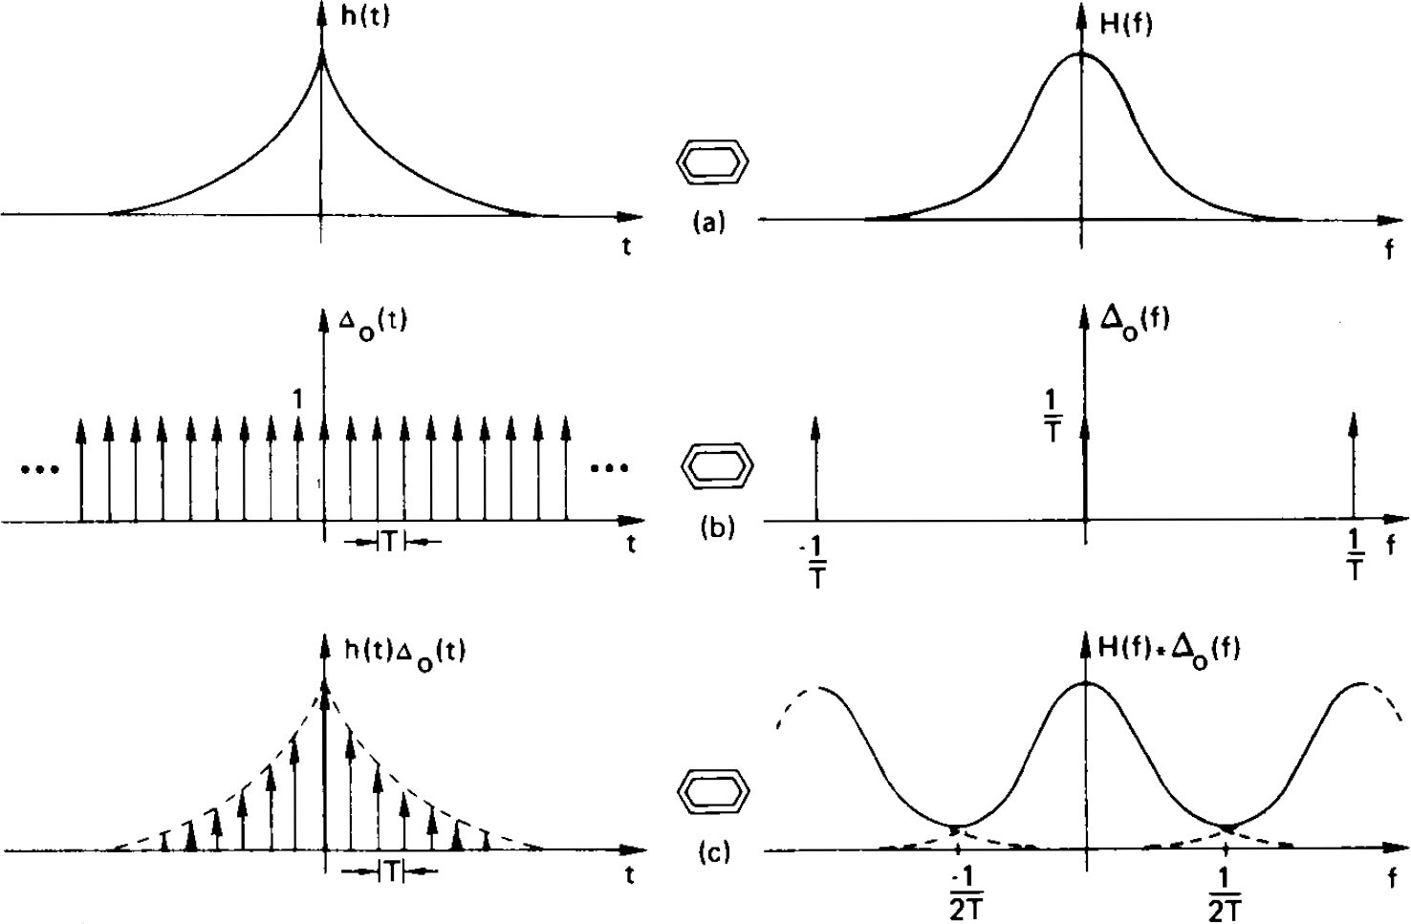
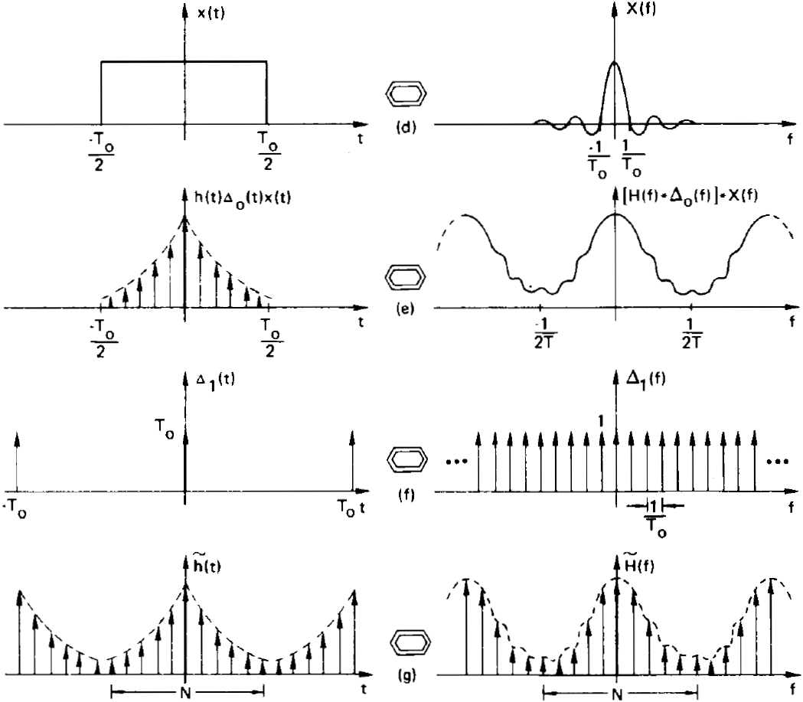
5. The Discrete Fourier Transform
Time domain sampling
Truncation
rippling
Frequency domain
sampling
aliasing
Note that sampling in the time/frequency domain resulted in a periodic function of frequency/time;
N time samples and N frequency values represent one period of the time and frequency domain waveforms, respectively.

Slide 18
2. Mode-Locking Techniques
2.1 Passive Mode Locking
2.1.1 Using saturable absorber
Passive mode locking technique refers to those locking without any external
radio frequency (RF) signal for seeding. The pulses are formed passively
through the internal structure of the laser that gives more advantages (less
loss, high gain) to signal if it travels in the pulse form rather than in a CW. The simplest method is to insert a saturable absorber into the cavity. The saturable absorber is a nonlinear optical component whose absorption coefficient decreases when the optical intensity increases.
Thus, the pulse train with high peak intensity would pass through the
absorber with much less loss as compared to that in a CW laser with several
modes as the energy available is concentrated in the periodic pulses, thus a
stable pulse train can be formed in the cavity.

Slide 19
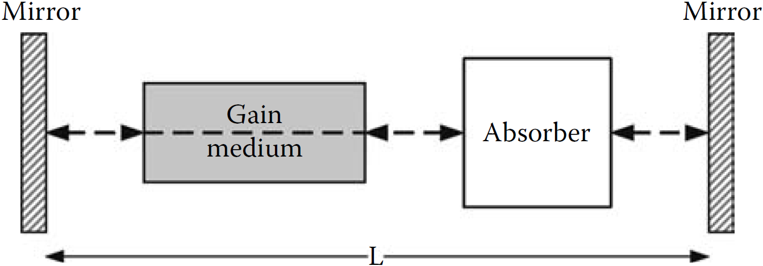
Schematic of a passive MLL integrated with a saturable absorber in the cavity

Slide 20
2.1.2 Using polarization rotation technique
Instead of using the saturable absorber, a nonlinear polarization rotation
(NPR) technique can be used for passive mode locking, as shown in the
Figure below. In this system, a nonlinear phase shift is imposed on the signal
with high peak power and thus rotates its polarization state to align with the
analyzer axis. The signal thus passes through the analyzer with minimum
loss. On the other hand, the CW signal with a low average power experiences
zero nonlinear phase shift and thus its polarization state is not rotated
to align with the analyzer axis. It is then blocked by the analyzer. Therefore,
pulses with high peak power are formed in the cavity instead of the CW
with a low average power.

Slide 21
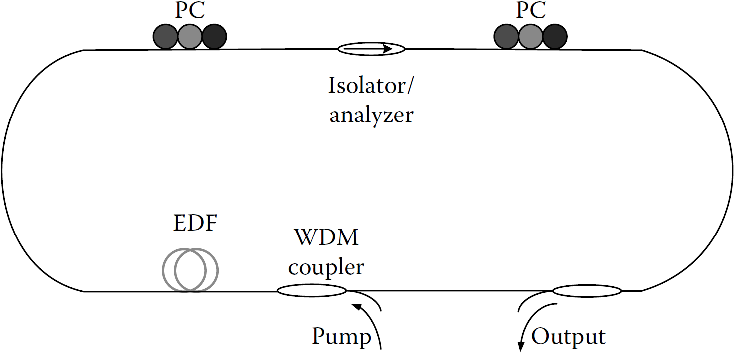
Schematic of an NPR passive MLFL

Slide 22
2.1.3 Advantages and Disadvantages of Passive MML
A passive mode-locked laser (MLL) has the potential to produce a very
short laser pulse, down to femtoseconds. The shortest pulse generated in the communication wavelength window to date is 5 fs?
Moreover, passive mode-locking is a self-locking phenomenon, it means that the pulse is formed without any external modulating signal.
However, the spacing between two pulses is varied from pulse to pulse since there is no control mechanism to force the pulses to be equally spaced. This is the disadvantage that makes passive MLLs not suitable for high-speed optical transmission systems, in which precise timing from pulse to pulse is required.

Slide 23
2.2.1 Active Mode Locking by Amplitude Modulation
In actively MLLs, mode locking can be induced either by amplitude modulation (AM), phase modulation (PM), or frequency modulation (FM). When amplitude is modulated by an external RF signal with a frequency of f_{m}, the oscillating mode at the optical frequency f₀ shades its energy to the two side bands located at f₀+f_{m} and f₀-f_{m}, as shown in the Figure below. If the modulating frequency f_{m} is chosen so that f_{m}=f_{R}, the side bands are coincident with the adjacent modes of the laser and hence the energy from ith mode is transferred to its adjacent (i+1)th and (i−1)th modes. In other words, the energies of the modes in the laser are transferred from one to the other. This causes the phase of the modes locked together and hence a mode-locked pulse train is formed.

Slide 24
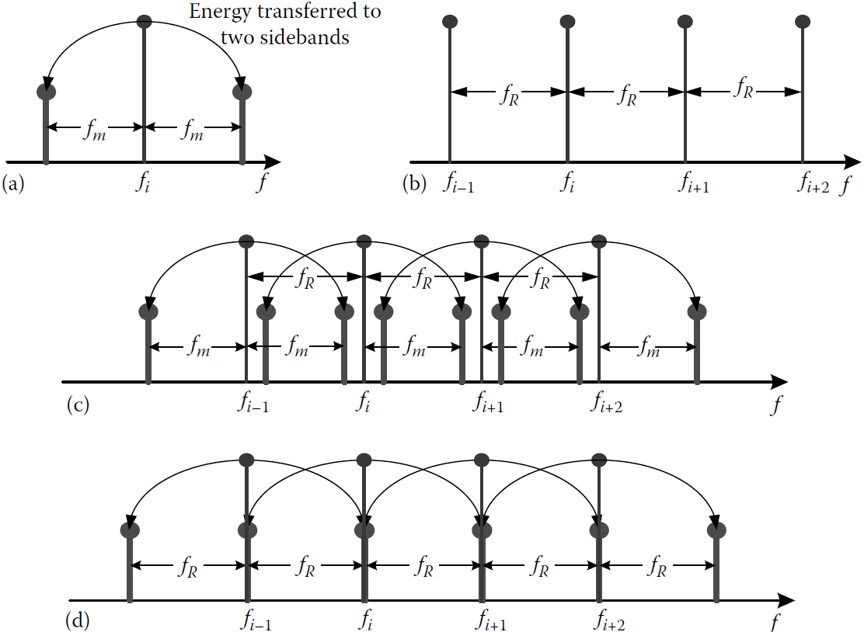

Slide 25
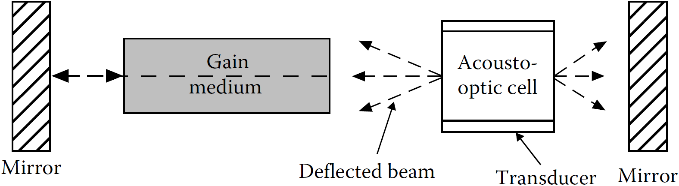
In actively MLLs, mode locking is induced by modulating the gain or loss
of the cavity with an external signal at the fundamental frequency fR.
A common method of active mode locking is inserting an acousto-optic
modulator (AOM) into the cavity, as shown in the Figure below. This is the first
method used in the experiment for the observation of mode-locked pulses in a helium–neon laser. The AOM is used to deflect light energy from the cavity by varying the refractive index of the medium in a standing wave profile. Thus, the undeflected beam is amplitude modulated.
AOM is widely used in several MLLs as it offers a very low insertion loss. However, the operating frequency of the AOM is limited and far below the pulse rate required for modern optical communication, typically, from a few hundred megahertz to a few gigahertz depending on the acoustic velocity of the acousto-optic material.

Slide 26
Due to the limited bandwidth of AOMs, they are normally replaced by LiNbO3 (铌酸锂)intensity or phase modulators whose bandwidth may reach 40 GHz or higher in high repetition rate actively MLLs.
In addition, all-fiber cavity is also used in those lasers to take advantage of fiber lasers such as low threshold, single mode, and high beam quality. Moreover, high optical intensity in a small cross section of the fiber enables one to obtain nonlinear effects for short pulses with even a low pump power.
Another method of mode locking is to modulate the gain of the amplifying medium as in Refs. [?,?]. In those experiments, the gain of the semiconductor amplifier is modulated by an external modulating signal. The lightwaves therefore experience a periodical gain and form the mode-locked pulses in the cavity. A semiconductor laser has the potential to generate very short pulses due to its wide spectral gain region.

Slide 27
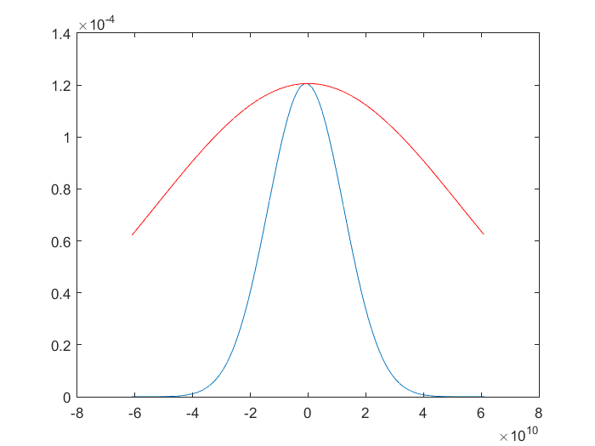
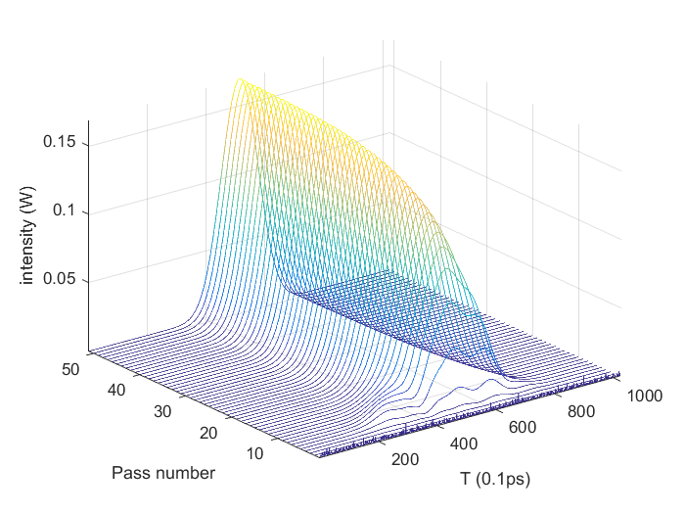
2.2.2 Stimulation of Active Mode Locking by Amplitude Modulation
Pulse generation
Spectrum

Slide 28
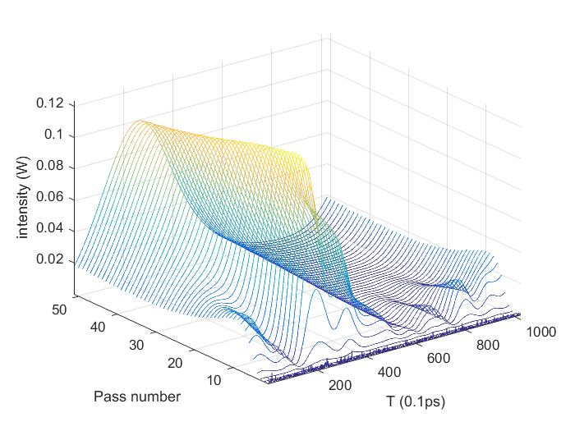
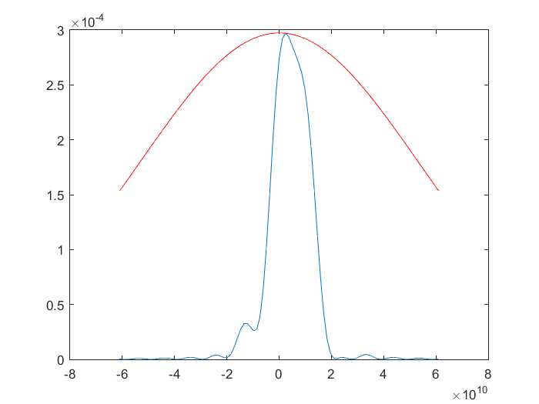
Without AM, mode locking will not be stable
Pulse generation without AM
Spectrum without AM

Slide 29
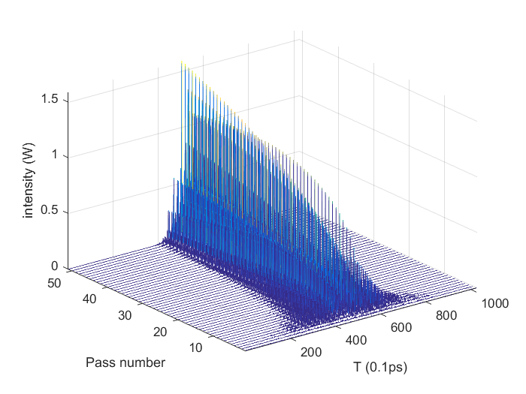
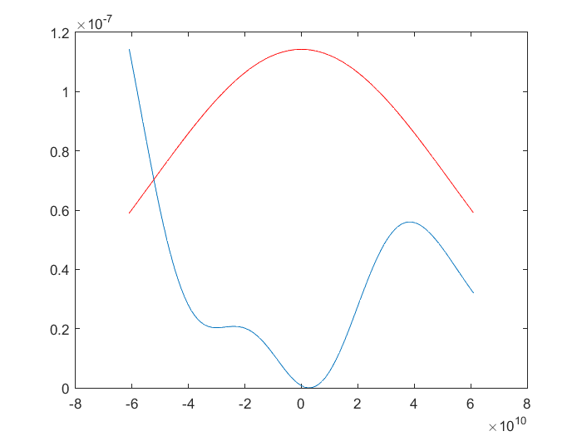
In a mode-locked fiber ring laser (MLFRL),
Without frequency filter, high frequency noise would deform the laser pulses
Pulse generation without frequency filter
Spectrum without frequency filter

Slide 30
2.3 The mechanism of Kerr-lens mode-locking is supposed to be soft-aperture effect
Nd:YVO₄[2008, Y. F. Chen], Nd:GdVO₄[2009, Y. F. Chen], Ti:Al₂O₃ mode-locking lasers[1999]
[2008, Y. F. Chen]. National Chiao Tung University, Hsinchu, Taiwan, “Compact efficient multi-GHz Kerr-lens modelocked diode-pumped Nd:YVO4 laser”, OE
[2009, Y. F. Chen], “Picosecond optical vortex converted from multigigahertz self-mode-locked high-order Hermite–Gaussian Nd:GdVO4 lasers”, OL
[1999]. U. Morgner, F.X. Kartner, S.H. Cho, Y. Chen, H.A. Haus, J.G. Fujimoto, E.P. Ippen, V. Scheuer, G. Angelow, and T. Tschudi, Sub-two-cycle pulses from a Kerr-lens mode-locked Ti: Sapphire laser, Opt. Lett., 24, 411–413, 1999.

Slide 31
2.4 For the laser materials that is not a self-focusing medium, a Hard-aperture is used to control transverse modes
In the experiments of CuBr vapor lasers, highly stable SML pulses have been obtained by using an aperture to control transverse modes. [1992, J. Geng]
[1992, J. Geng]. J. Geng, G. Zhang, X. Song, and F. Lin, “Highly stable self‐mode locking and the longitudinal mode structure in CuBr laser” Appl. Phys. Lett. 60, 2969(1992).
Kerr lens mode locking Pr YLF with hard aperture [1995,1996,OL]

Slide 32
2.5 Narrow-band width self-mode-locking lasers
Gas lasers generally has narrow band width of the gain
a copper vapor laser not only has the largest power density (about 10⁵ W/cm²), but also has the largest gain linewidth (about 10¹⁰ Hz). If the electric field is induced by the intra-cavity laser field. The power density must be about 10⁵-10⁶ W/cm² to satisfy the SML criterion. In fact, it is difficult to reach such a power density by an intra-cavity laser field. Therefore, the SML is unstable.
For a He-Ne laser, its gain linewidth is the narrowest and its power density is the lowest in three kinds of lasers. The analysis shows that its SML is usually unstable again.
For a CuBr laser, its linewidth is narrower than a copper vapor laser since its operating temperature is lower, then its SML needs lower power density; although its linewidth is larger than a He-Ne laser, its power density has much larger. Therefore, its SML is the easiest and stablest in the three kinds of lasers.

Slide 33
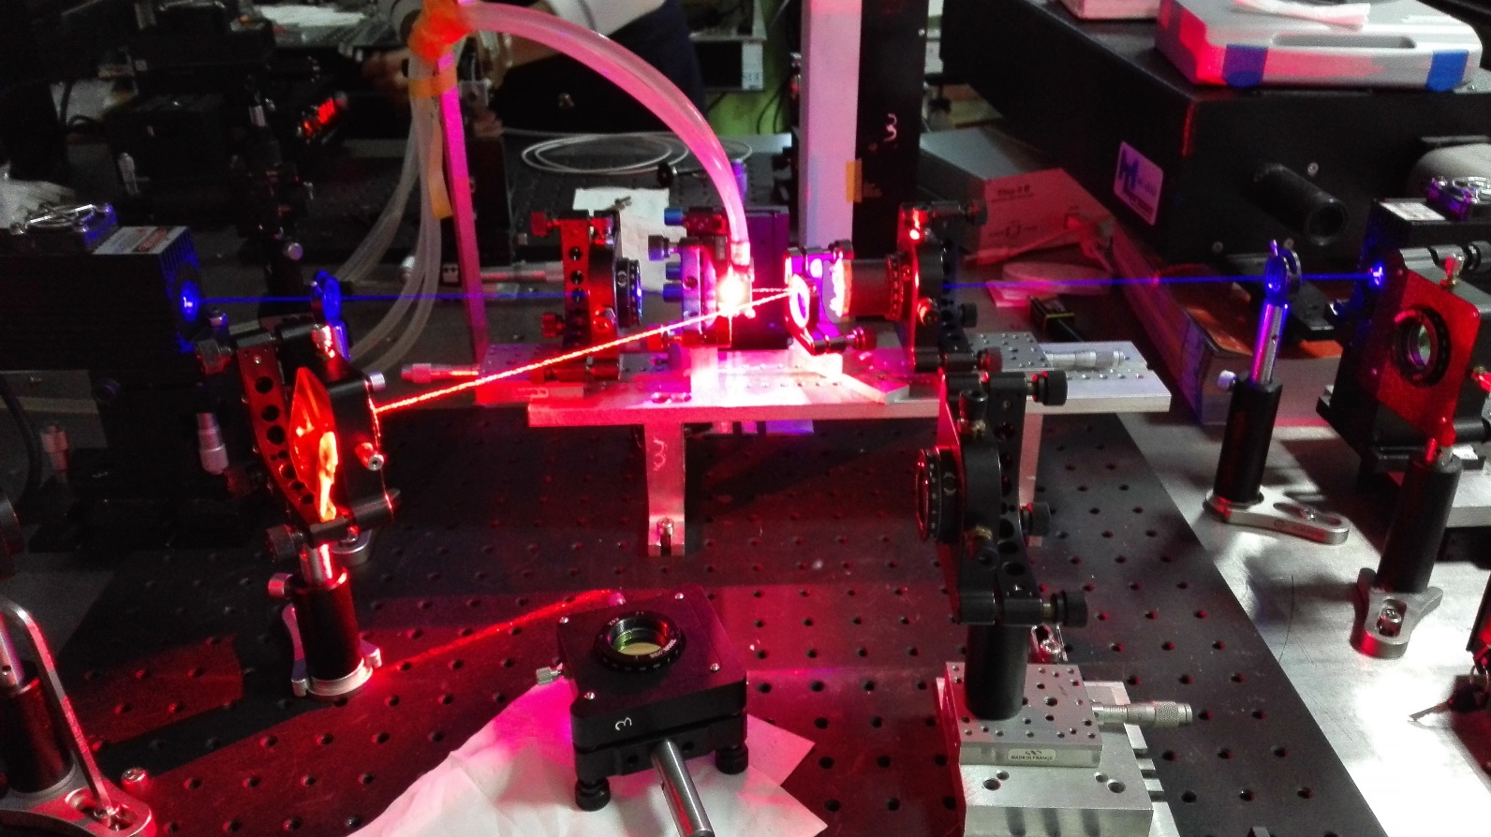
Self-Mode-Locking
0.3 m cavity

Slide 34
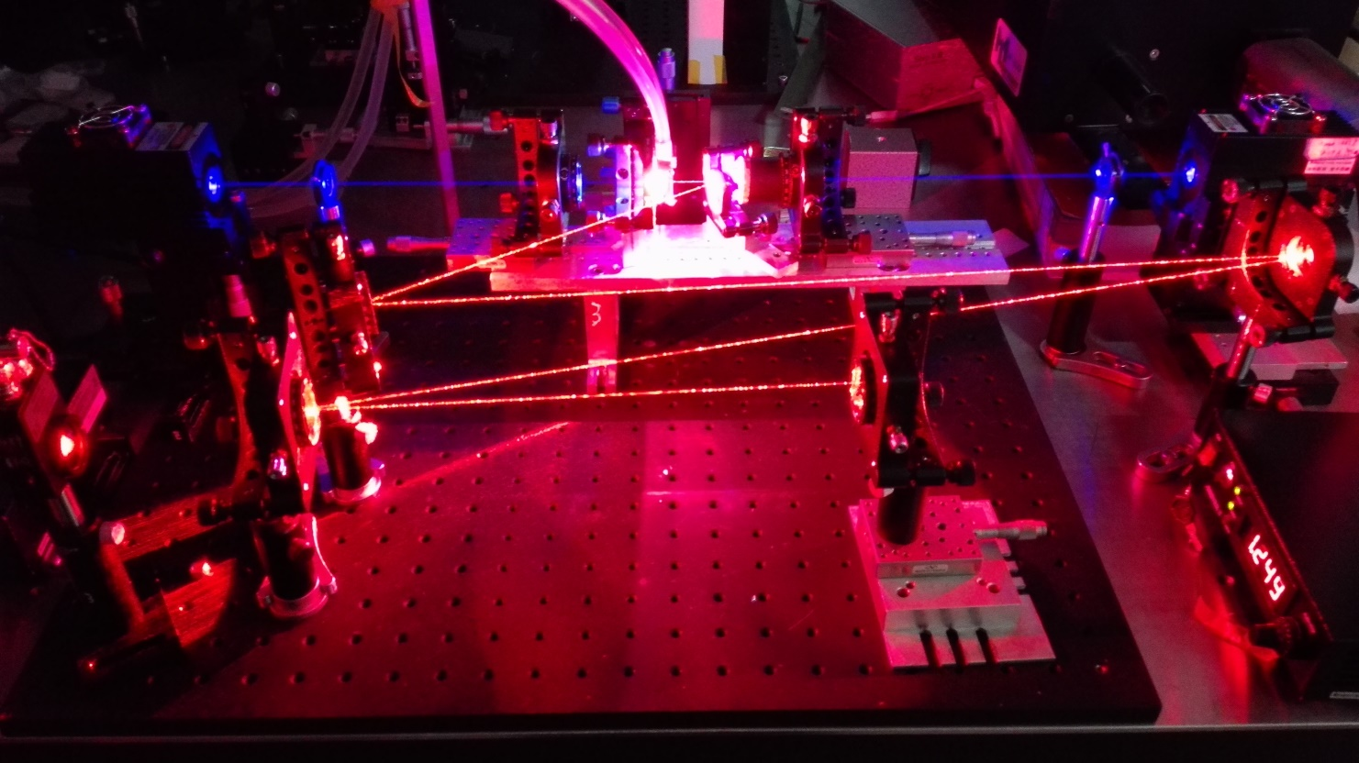
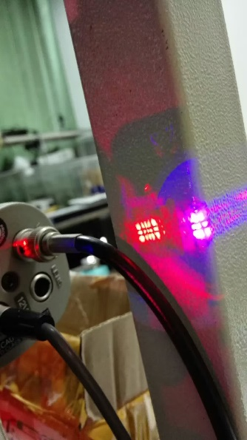
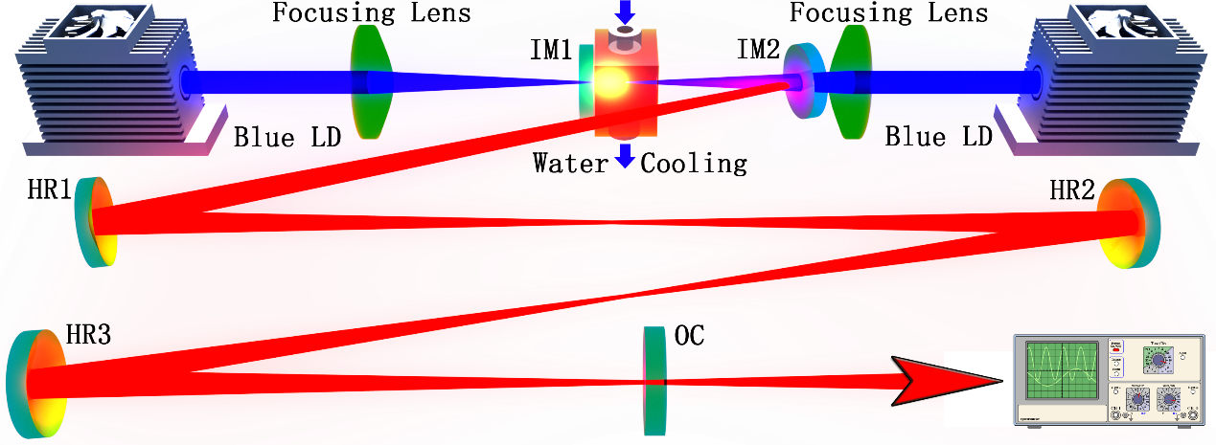
Kerr mode-locking
1.8 m cavity

Slide 35
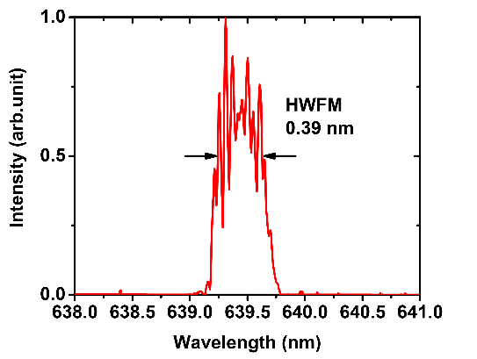
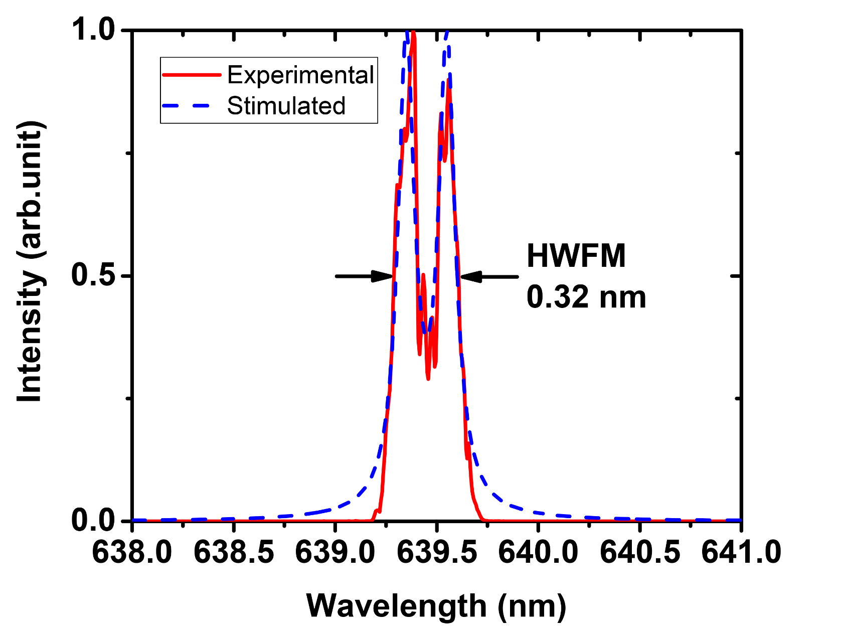
Lorentzian line shape
Line shape with the frequency shift of the Stark splitting from the unperturbed frequency induced by the intra-cavity laser field

Slide 36
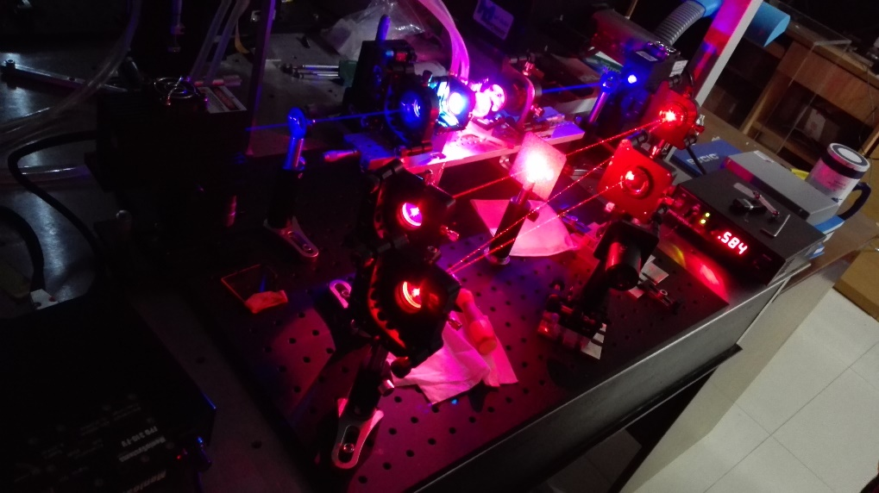
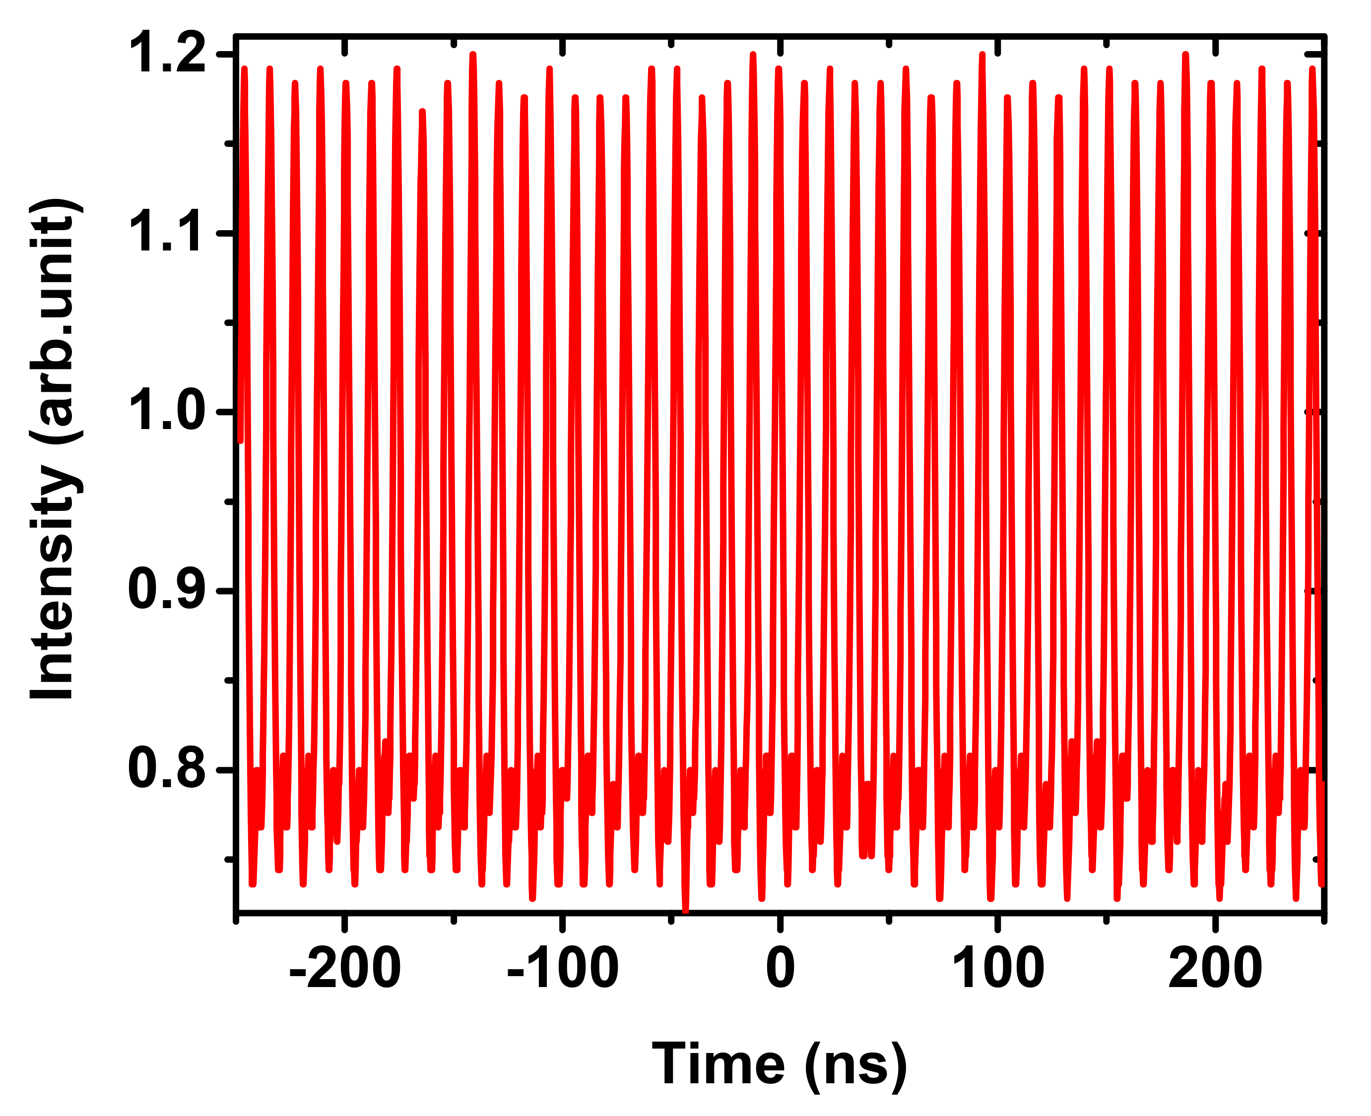

Slide 37
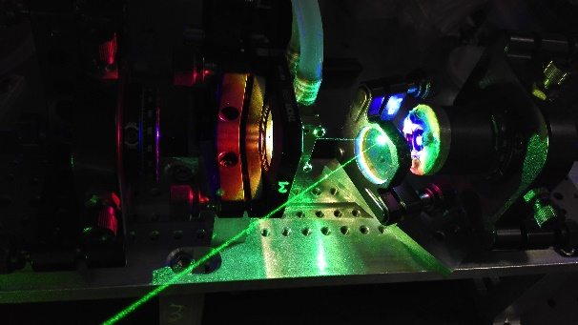
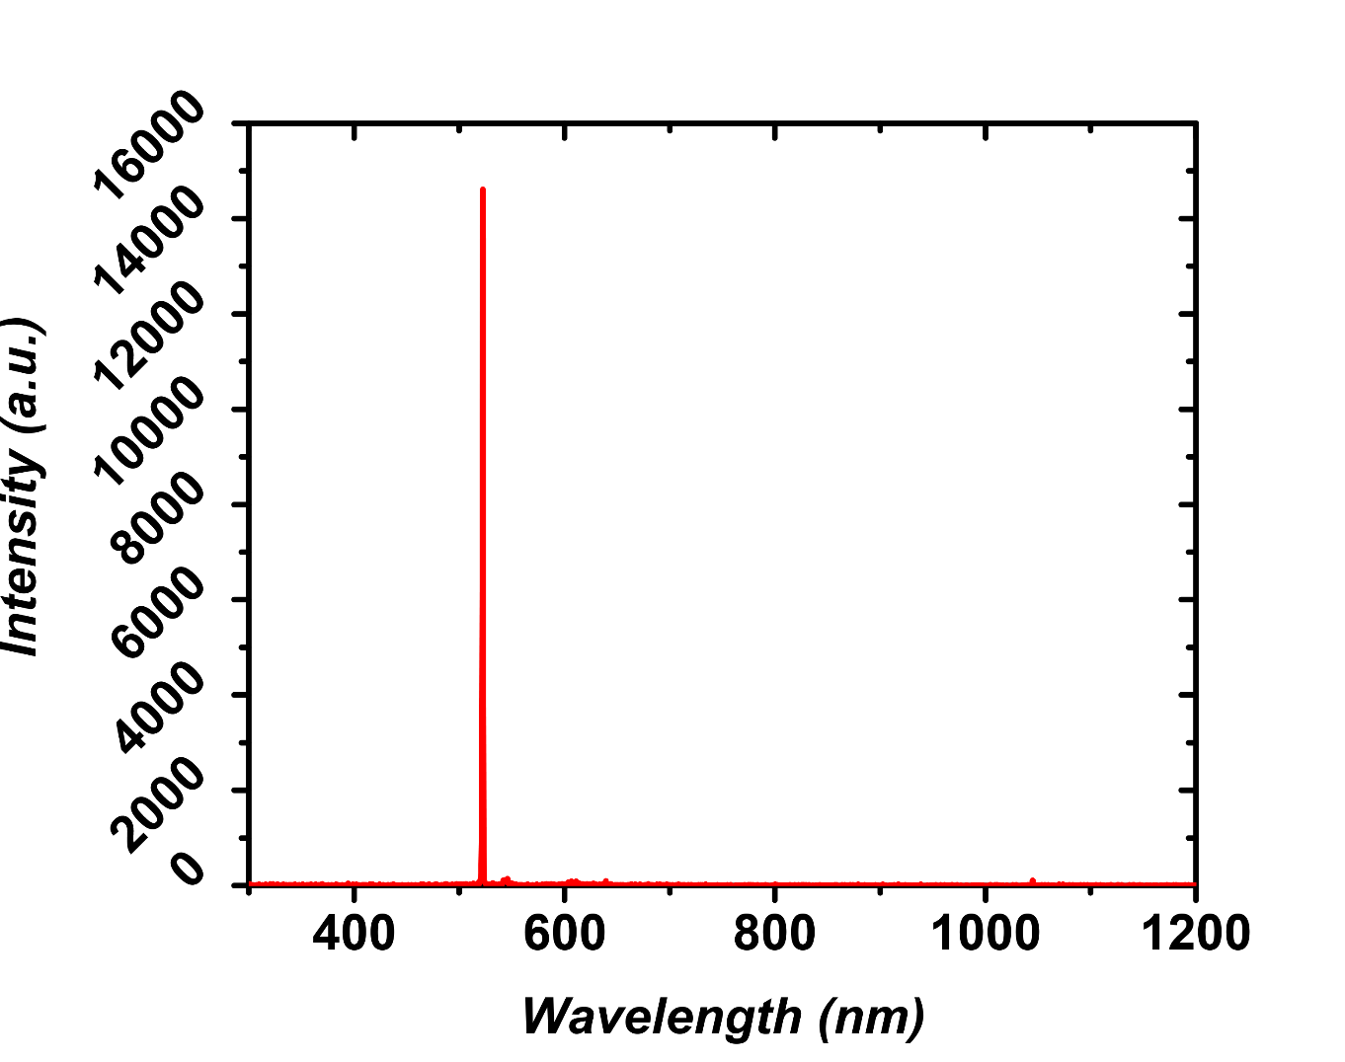
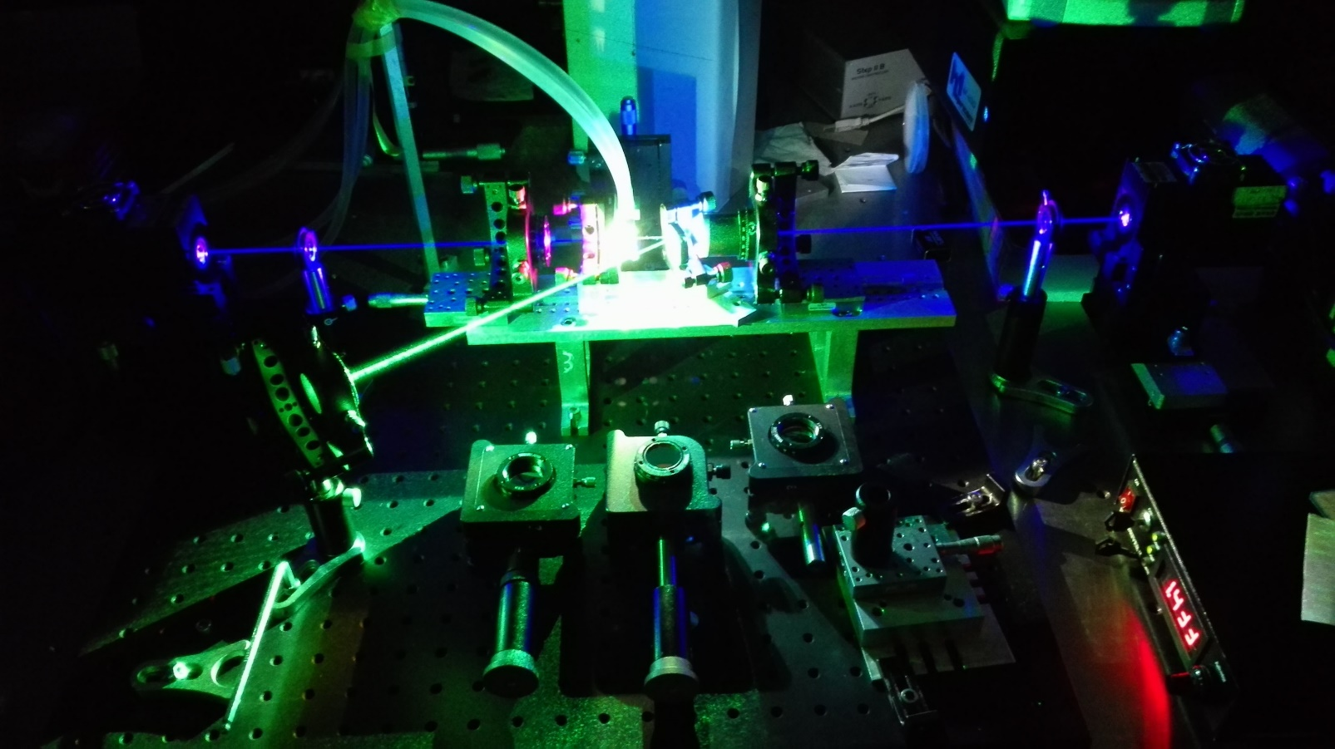
Green Self-mode-locking

Slide 38
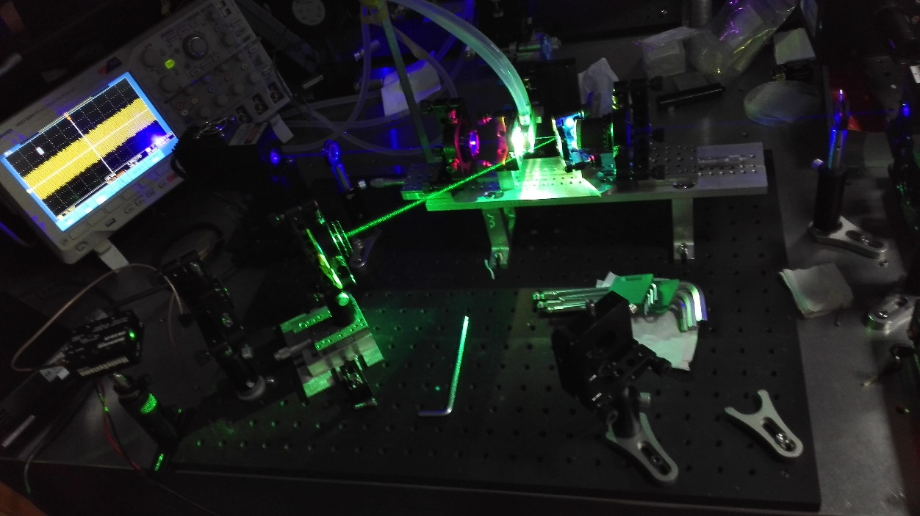
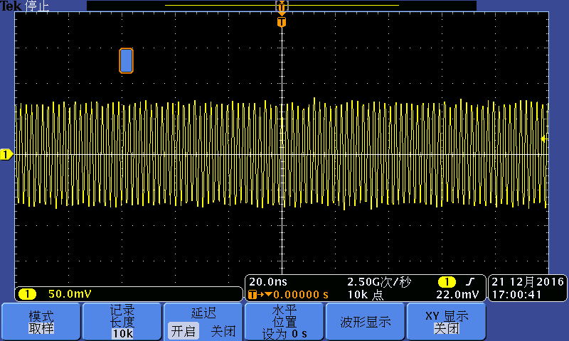
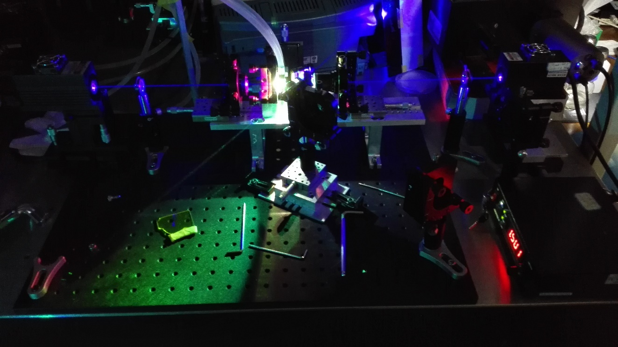
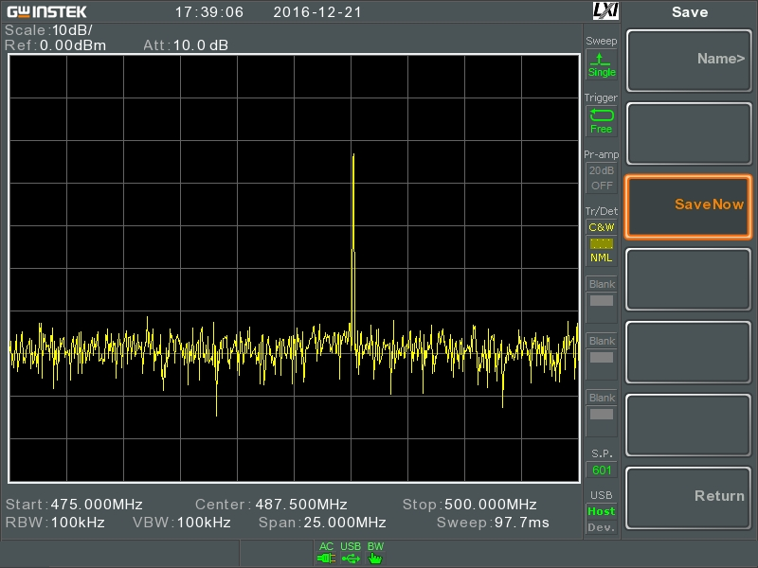

Slide 39
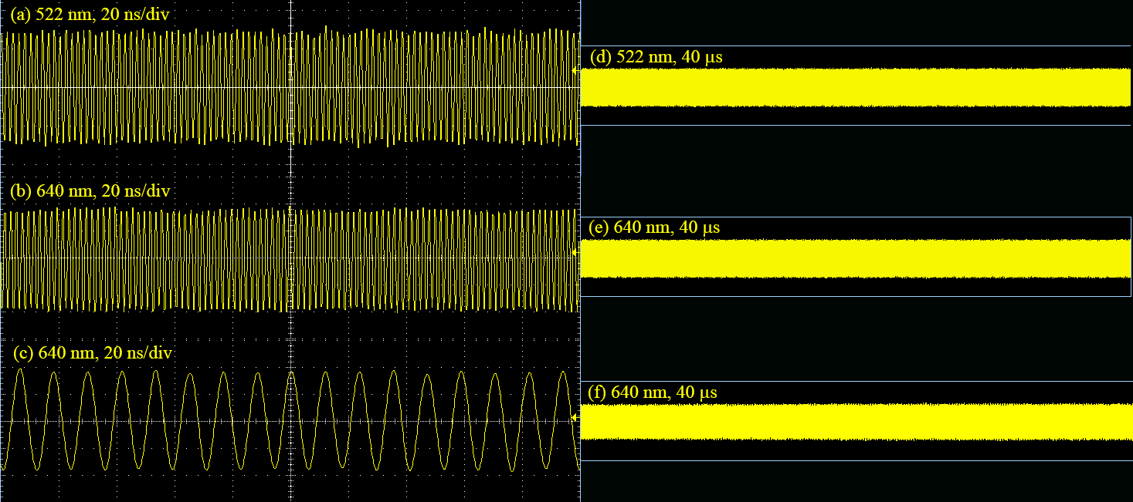

Slide 40
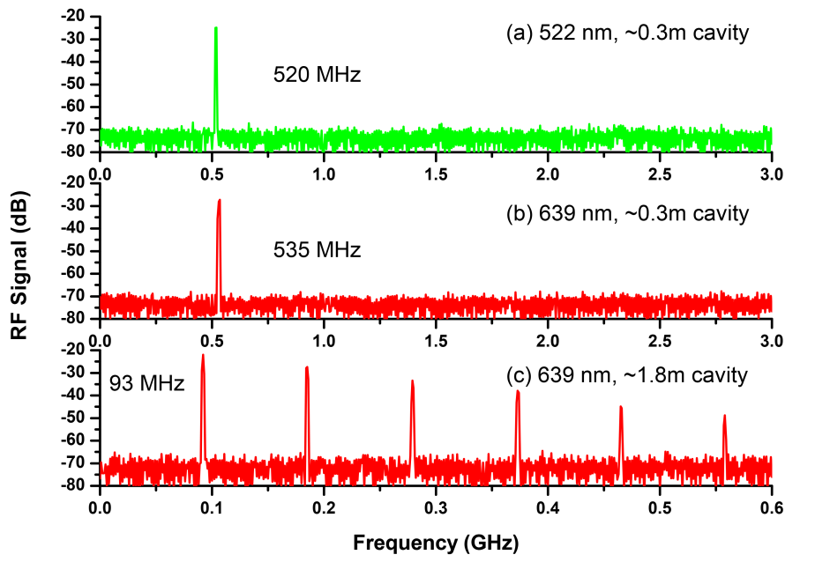

Slide 41

谢谢！

Slide 42
